Slide 1


A Slam Dunk Opportunity
A Multimedia Sponsorship Designed to Bring New Customers to Your Table

Slide 2
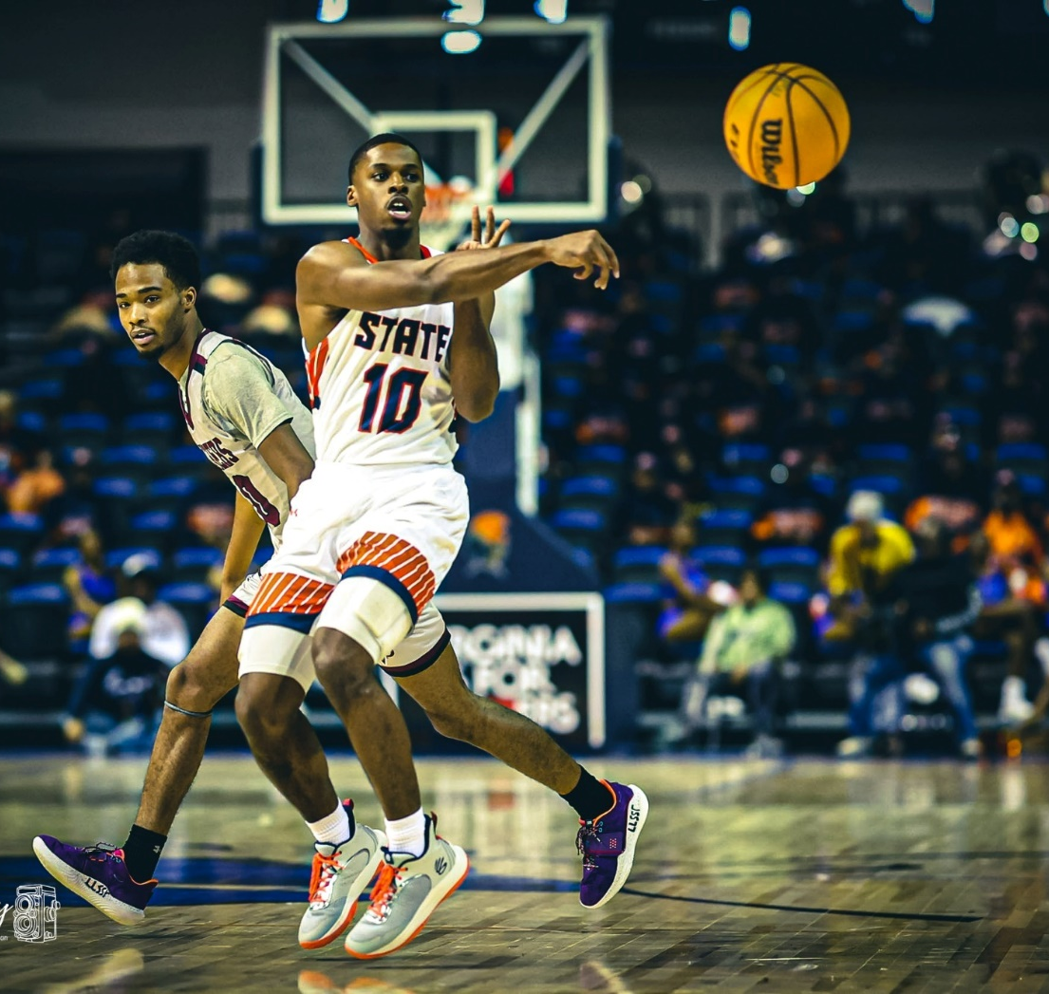
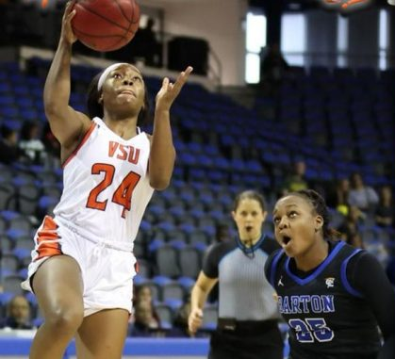
Schedules
NOTE:
To change images on this slide, select a picture and delete it. Then click the Insert Picture icon
in the placeholder to insert your own image.
Men’s team play 28 games a season with 15 of them home games
Women’s team plays 28 games a season with 15 home games

Slide 3
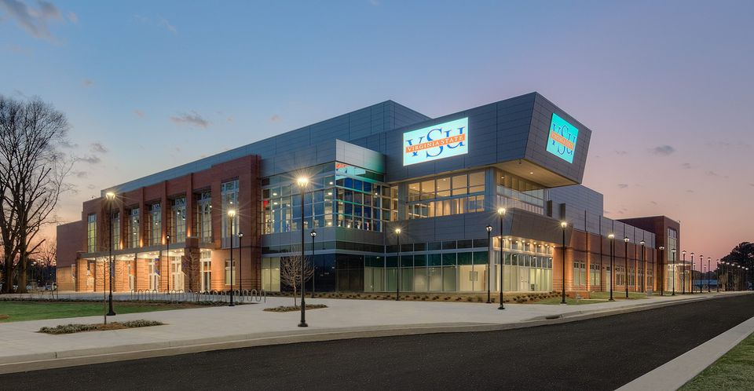
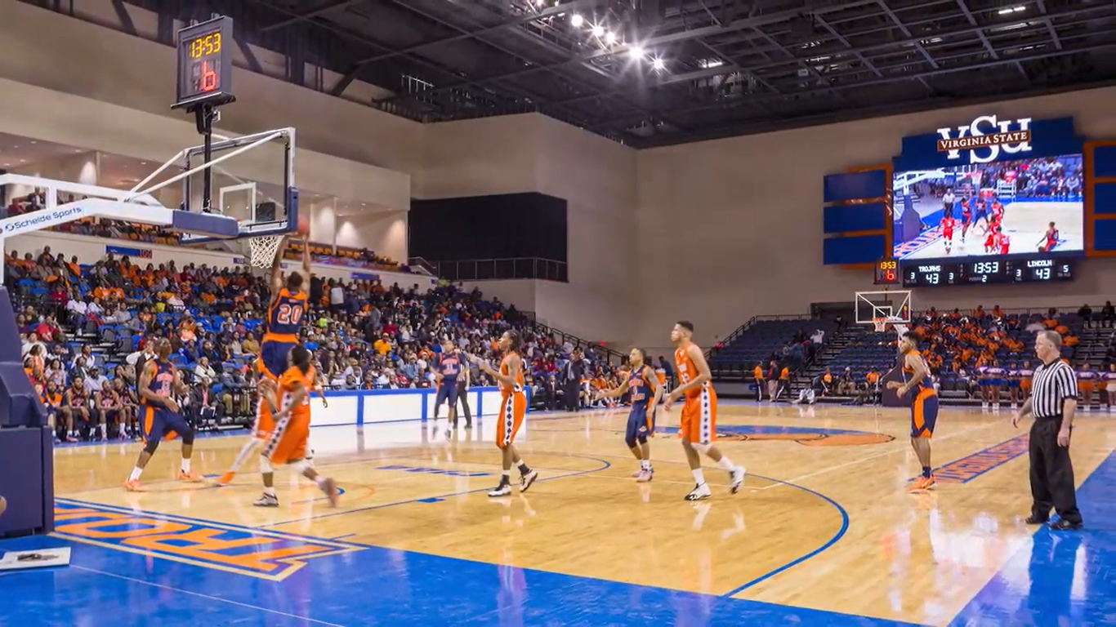
The Multi Purpose Center at VSU
Seats 5,100 during basketball games
Digital Scoreboard with video advertising capability
Courtside Digital Advertising Panel Boards

Slide 4
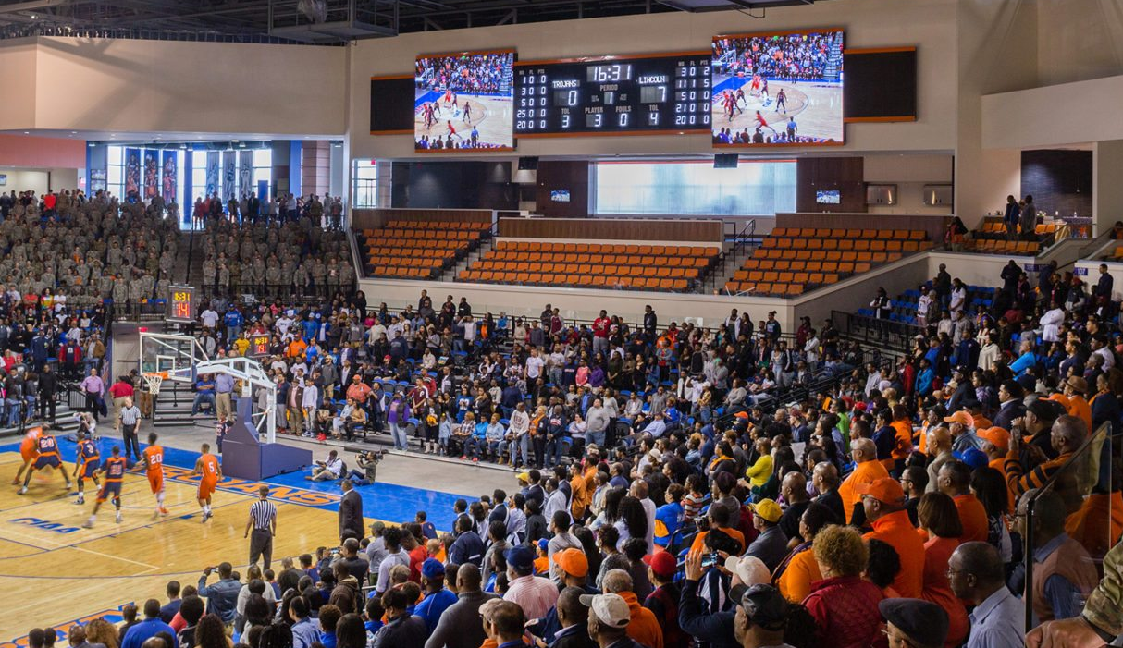
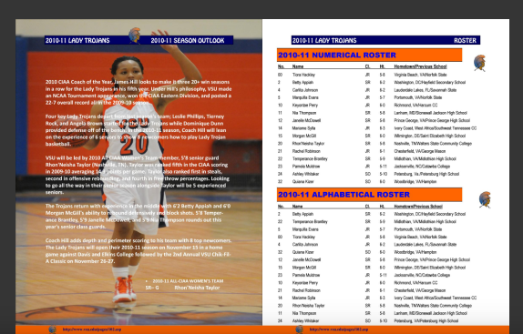
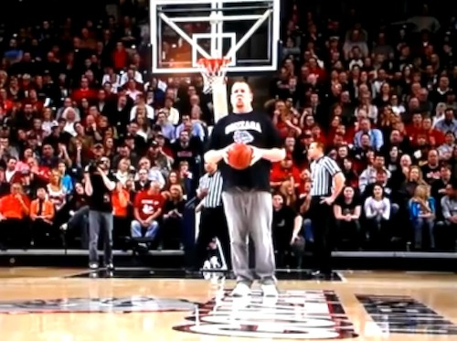
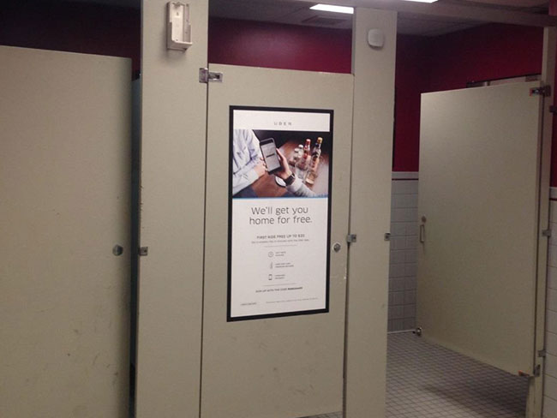
Assets In the Arena
Digital & Banner Signage in Arena
Couponing and Sampling Activation
Crowd Interaction with Promotional Stunting
Electronic and Printed Program Ad Placement
Public Address Announcements

Slide 5
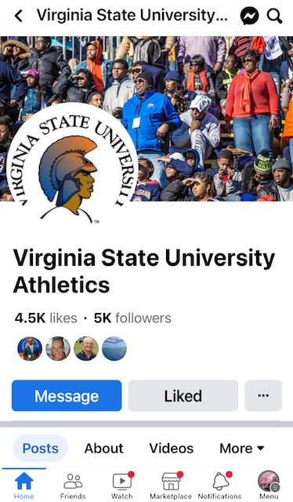
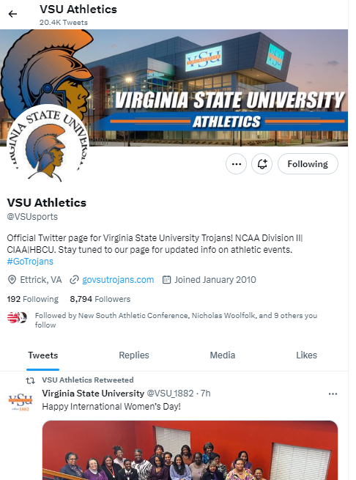

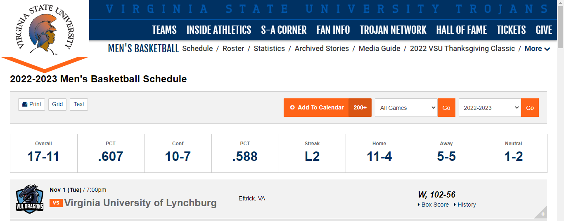
Traditional & Social Media Inclusion
Website
Instagram
Facebook
Twitter
WVST 93.1 FM Radio Broadcasts

Slide 6
MVP Sponsorship $30,000
STARTING FIVE Sponsorship $20,000
ONE ON ONE Sponsorship $10,000

Slide 7
MVP Sponsorship $30,000
Four :15 Video Spots on Scoreboard Digital Screen during games
One permanent Courtside Panel Board Ad
Crowd Interaction with Stunting On Court during Media Time Out
Couponing and Sampling Opportunities in Arena Concourse Area
Public Address Announcements Before Game and at Halftime
Includes ½ Page Ad in both Men’s & Women’s Digital and Printed Program
60 Second Commercials running 10 x in Radio Broadcast of Men’s & Women’s games
60 Second Commercials running 2 x in Men’s & Women’s Coaches Shows
Logo on Men’s & Women’s Team Website Pages
Mentions on all Social Media Platforms – Twitter, Facebook, Instagram
Four VIP Tickets for All Men’s & Women’s Home Games

Slide 8
STARTING FIVE Sponsorship $20,000
One :15 Video Spots on Scoreboard Digital Screen during games
One permanent Courtside Panel Board Ad
Includes ¼ page Ad in both Men’s & Women’s Digital and Printed Program
60 commercial running 2 x in radio broadcast of Men’s & Women’s games
60 commercial running 1 x in Men’s & Women’s Coaches Shows
Logo on Men’s & Women’s Team Website Pages
Mentions on all Social Media Platforms – Twitter, Facebook, Instagram
Couponing and Sampling Opportunities in Arena Concourse
Two Tickets for All Men’s & Women’s Home Games
STARTING FIVE Sponsorship $20,000
STARTING FIVE Sponsorship $20,000

Slide 9
ONE ON ONE Sponsorship $10,000
One permanent Courtside Panel Board Ad
Includes 1/4 page Ad in both Men’s & Women’s Digital and Printed Program
Logo on Men’s & Women’s Team Website Pages
Mentions on all Social Media Platforms – Twitter, Facebook, Instagram
Two Tickets for All Men’s & Women’s Home Games

Slide 10
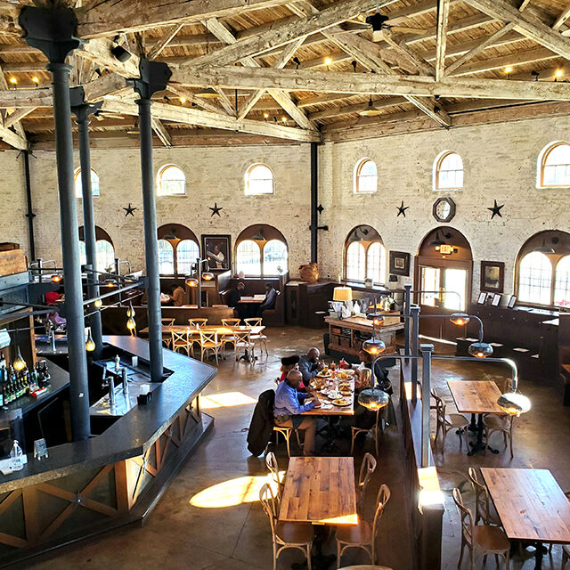



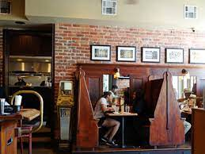
A WINNING TEAM

